Slide 1
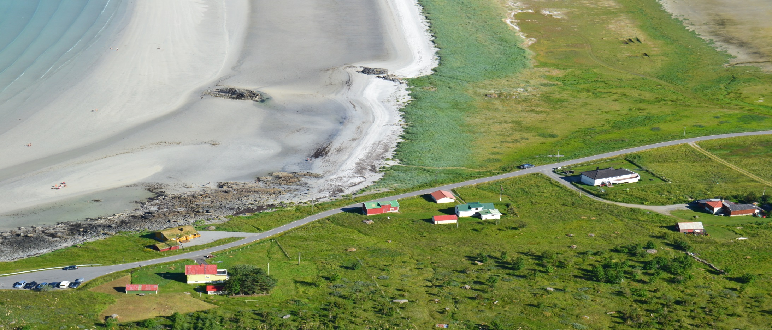
Democracy and equity – the local community in the school
Ragnhild Liland og Agneta Knutas
NTNU, Program for lærerutdanning
  The school is the glue in the local society together with the church, the food store and the sports club, but the school is the most important of these. A village requires a school – if not the village is nothing more than a bedroom community. (Women, grandmother)

Slide 2
The Nordic Model
Norway, Sweden and Denmark
«The Nordic model«
welfare state, equal opportunities
The Welfare State indicates
  social engagement
  secure interest of every citizen and
supporting solidarity

Slide 3
The Nordic Model of Education
Arnesen & Lundahl, 2006, Frimannsson 2006, Antikainen, 2006, Telhaug, Mediås, Aasen 2006)
  Free education from 6 to end of University.
  No selection, tracking or streaming of students until the age of 16.
  «The classroom as cultural canon»
    Emphasis on democratic values and participation, democratic socialization of pupils,
  School´s task to reduce social class differences.
    build democracy, solidarity, cooperation – support equity

Slide 4
Why is the Nordic Model interesting?
Marketliberalism and NPM
Restructuring school system in the Scandinavian countries during the 1990s.
Market liberalism and New Public Management
  Democracy stands the risk of becoming thin or weak.
    Worries: democracy will only work as a means to securing citizens’ rights

Slide 5
On the topic of Politics and Education
(Utdanningsdirektoratet, 2013).
11 % less schools in Norway during 10 year-period.
50 % of the schools that were closed had less than 34 students the last year the schools were open.
550 schools less

Slide 6
Pilot study
We enter the research field with a broad question and ask:
“What experiences do the local citizens in the local community have regarding “their” public school?”
Notes:
Toward the background of the Nordic model and changes in Politics we are curious to look at different discourses of democracy. To obtain our goal we interview local inhabitants in rural areas to find out more of their experiences regarding the school in the local society. These findings we have analyzed using theories of Rancière

Slide 7
Theory
(Rancière,1998)
Democracy as Regime | Democracy as Subjectivity
- The construction of a particular form: the “Police order” - “Police order” indicates something is already identified and Democracy thus only becomes a question of “who votes for what?” | - Equal right having the possibility to break in through speech and action - Equity understood as subjectivity concerns our right to disagree - Break with consensus in the ”gap” in-between speaking and acting humans.

Slide 8
Method and Analyze
Focusgroup
  Locals Citizens
  3 villages and 5 focus group interviews
  Analyze
    The information from the focusgroups are analyzed as discource
    power and hegemony
    Thin democracy and thick democracy

Slide 9
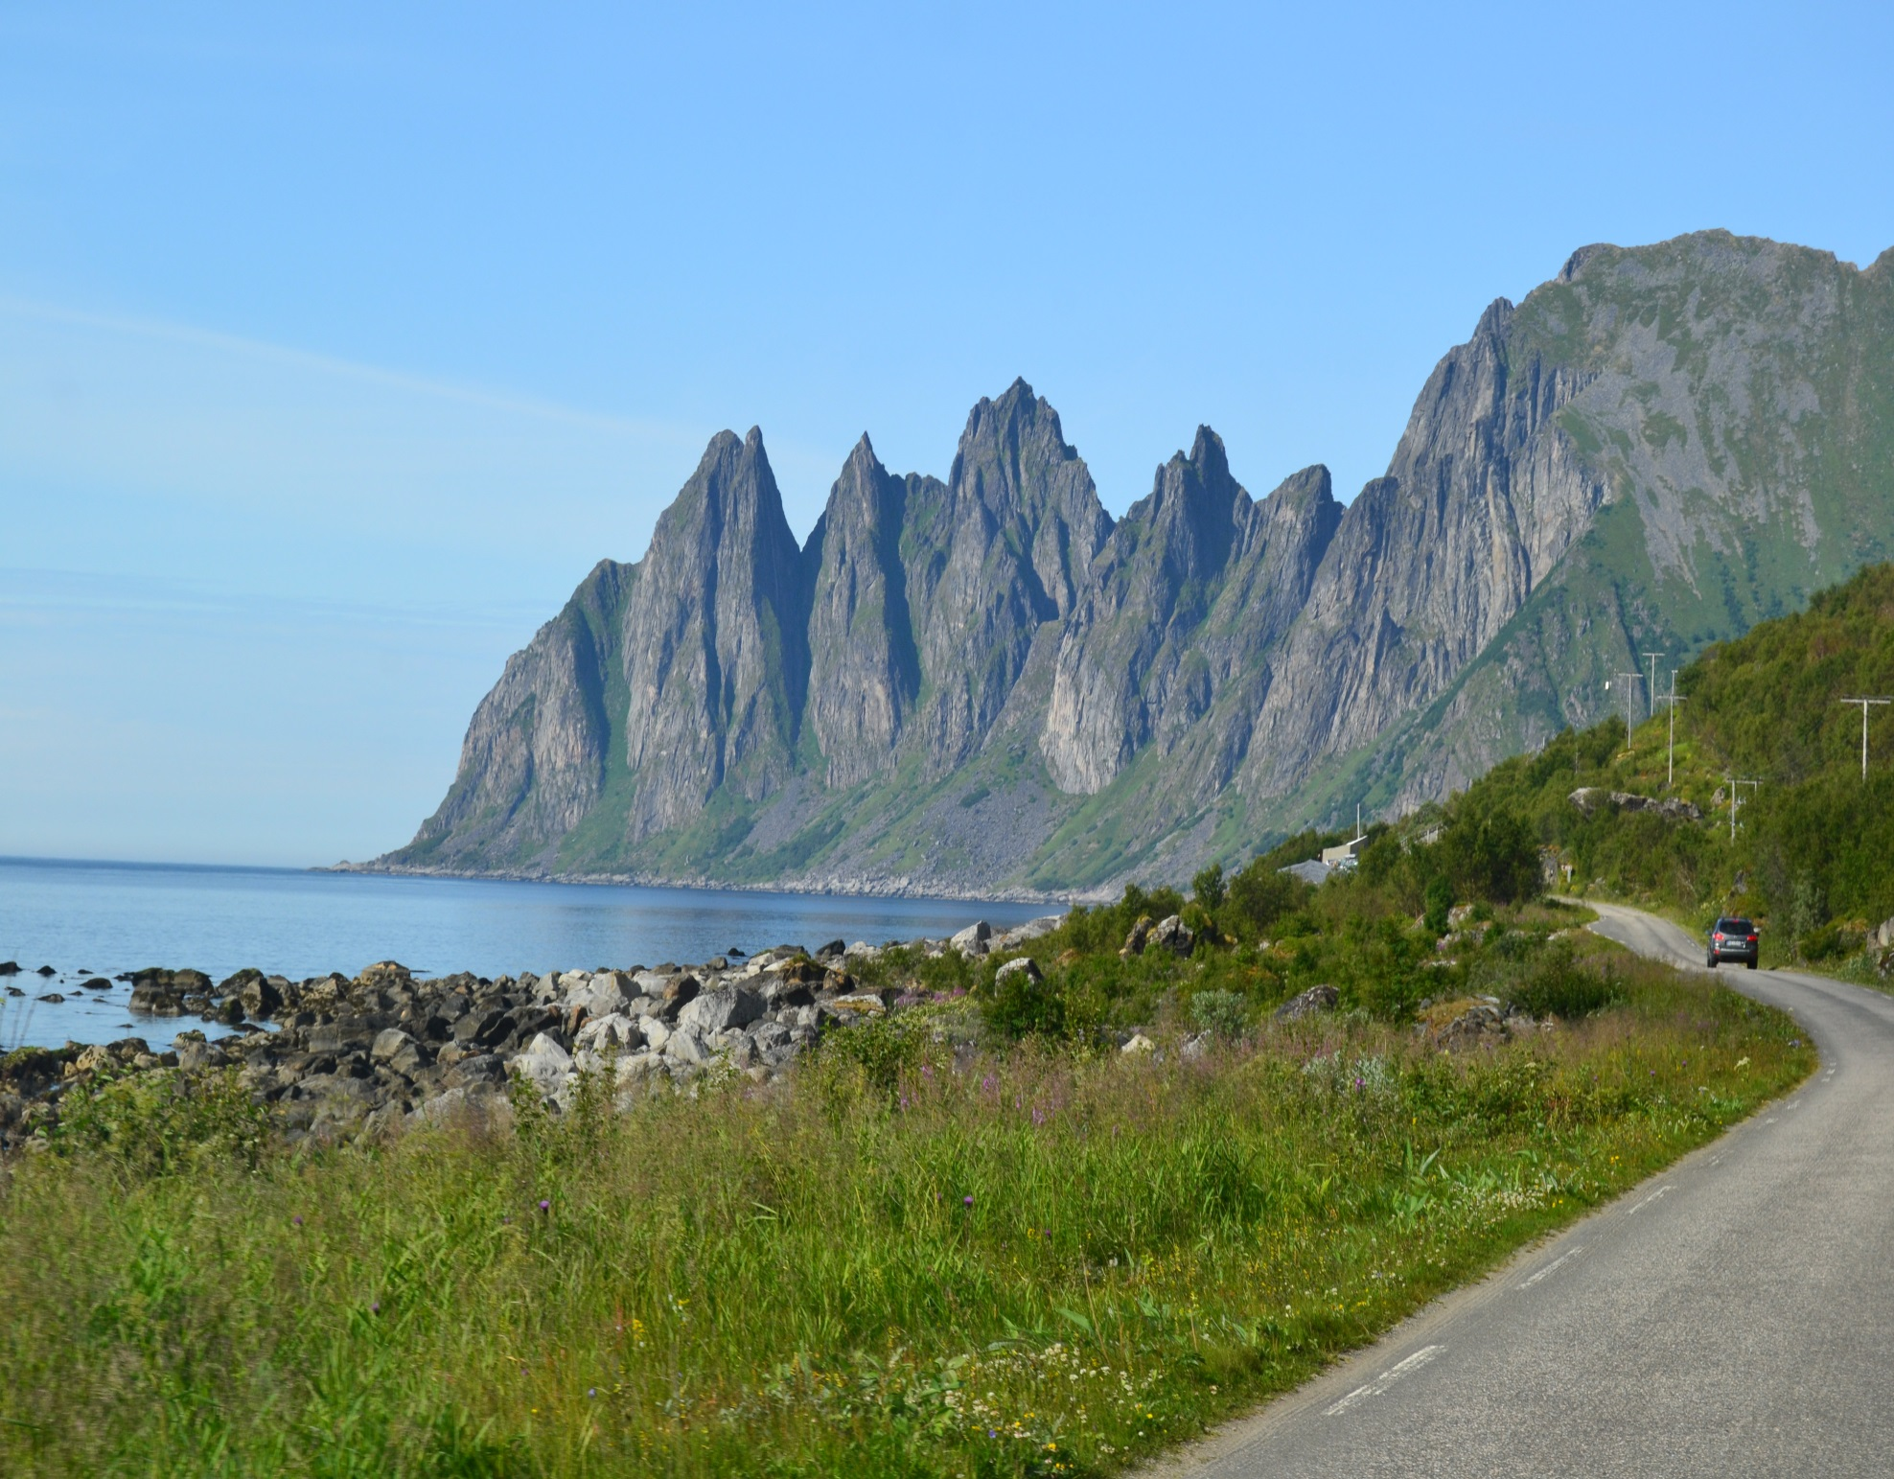
Before presenting the results

Slide 10
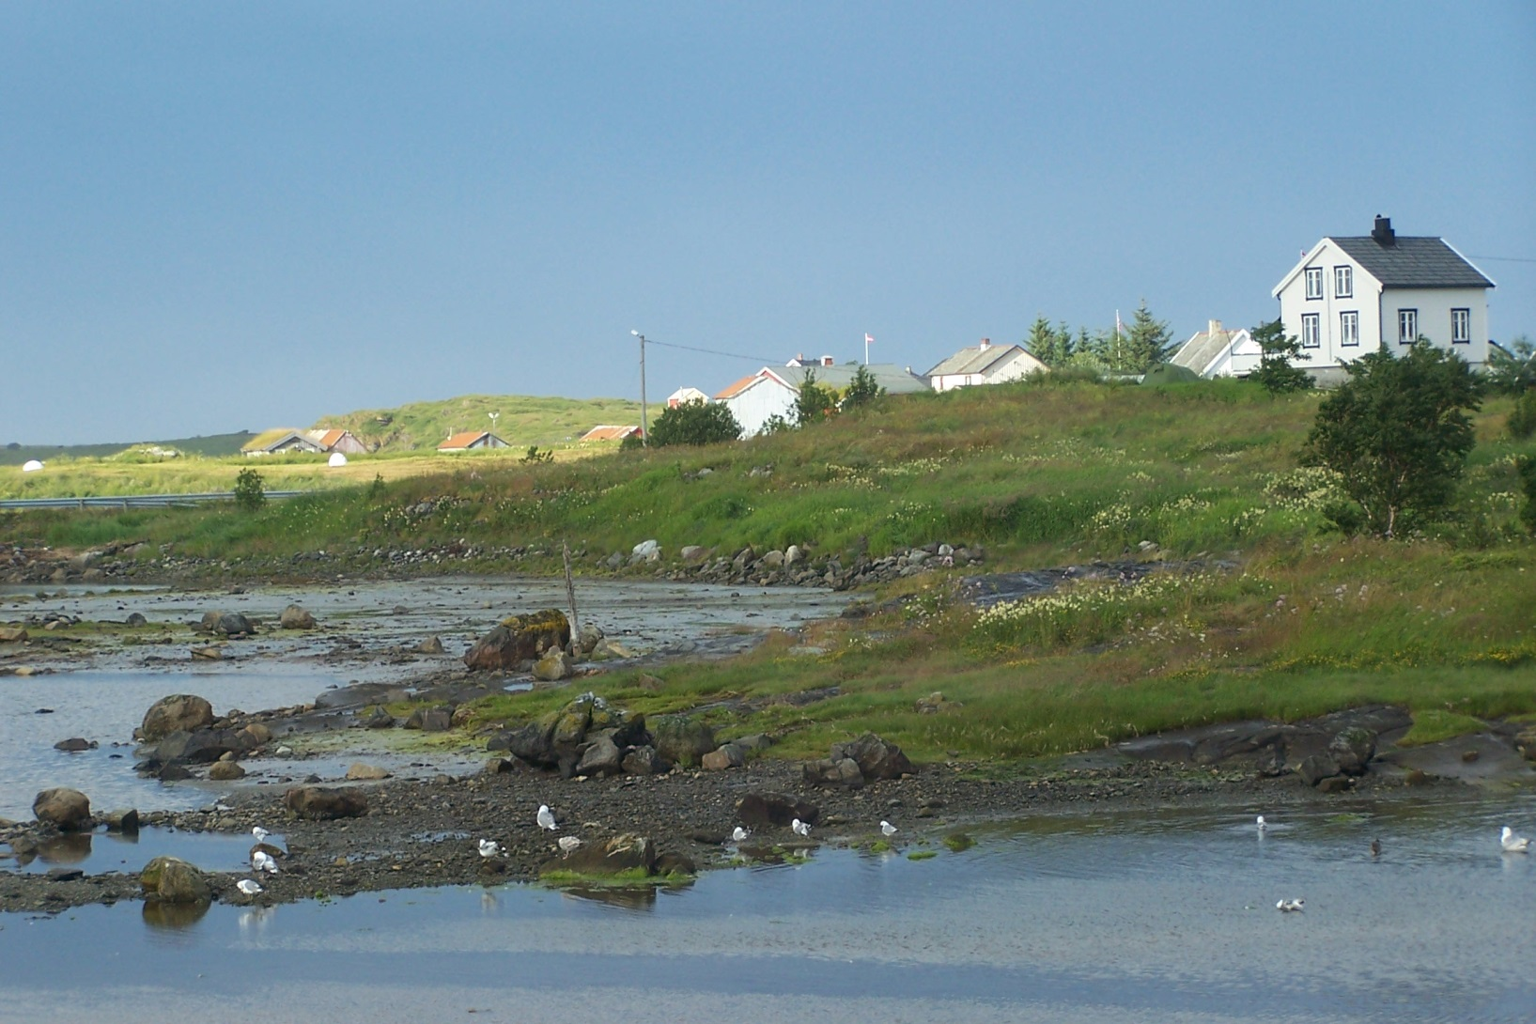
The hearth of the hub
The politicians are breaking our society apart when they are transferring the lower secondary school from our village to the municipality center. The politician (of the municipality) interrupts the local way of life. The children are spending their time on the bus instead of participating in the afterschool activities offered by the local society such as the sports club, the hunting- and fishing club. The children have no strength left to participate in these activities (Man, 45 years)

Slide 11
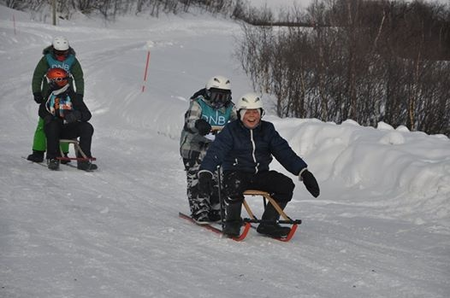
Take the highway

Slide 12
Result continued
  “Take the Highway” (School B)
  The roads in this area are not straight, but winding up and down the mountains. The bus driver transports our children with everybody’s life at stake. It ought to be forbidden to transport children under these conditions! A couple of years ago when the politicians started their campaign to transfer the lower secondary children to the municipality school the mayor and the chief (head) of the community board came to our village to brief us on the dramatic numbers of the economy to convince us the urgent need of transferring our children. Two shivering men arrived (too late) for the meeting after a horrifying ride up the mountain on slippery roads. When they where to part they asked us what would be most shrewd way to come back down the hill. “Take the same road as the bus commuting the children we answered”. These are well-educated intelligent people whom were scared to drive down the mountain one night – the same road that they argue we are to send our children every day. (Man 50 years)

Slide 13
Result continued
“Untidy Processes” (School C)
  The municipality wanted to close down our school. First of all we refused to accept the closing. We – the parents sent a letter to the municipality and applied to start a Montessori school. We were exposed to serious lobbying behind our back. The municipality sent correspondence to the government without including us in the process – it was our application and we ought to have received copy, weren`t we? They withheld us the right to respond and argue our cause. We got the message quite clearly worded from some representatives from the municipality; “if you keep arguing it will have consequences” We found it pretty harsh coming from the politicians! (Women, 30 years)

Slide 14
Discussion
The pilotstudy preliminary results,;
1.The Hearth of the Hub,
2.Take the Highway and
3. Untidy Processes
  indicate a discourse of thin democracy
Hegemonic discourses on democracy and power of resistance.
  Democracy we argue becomes thin.
  Recistance . The local citizens discource challenges the hegemonic political dominant discourse

Slide 15
The Nordic Model under pressure?
International and global influences on Norweigan education.
Thin Democracy – Thick Democracy
What kind of democracy is education and the local community to promote for next generation?

Slide 16
